Slide 1
RNA Probe Design & QC Pipeline
10 NOV 2020

Slide 2
RNA Fusion - Probe Design
From DNA:
Exact positions can be detected
Very high number of possibilities
No evidence of expression
Independent from gene isoforms
From RNA:
Exact positions often not known
Lower number of possibilities
Clear evidence of expression
Dependent on gene isoforms
BRK
BRK
E1
E2
E3
E1
E2
E3
5’ ISOF 1
5’ ISOF 1
E1
E2
E3
E1
E2
E3
5’ ISOF 2
5’ ISOF 2
E1
E2
E1
E2
5’ ISOF 3
5’ ISOF 3
TARGET REGION

Slide 3
RNA Fusion - Probe Design
Using RefSeq & Ensembl:
~200 possible combinations / fusion
Transcript scoring system
Probe position scoring system
All combinations ranked
1 or 2 probe sets extracted / fusion
From RNA:
Exact positions often not known
Lower number of possibilities
Clear evidence of expression
Dependent on gene isoforms
BRK
E1
E2
E3
120 + 0
5’ ISOF 1
90 + 30
60 + 60
E1
E2
E3
30 + 90
5’ ISOF 2
0 + 120
5’ GENE
3’ GENE
E1
E2
5’ ISOF 3
BREAKPOINTS

Slide 4
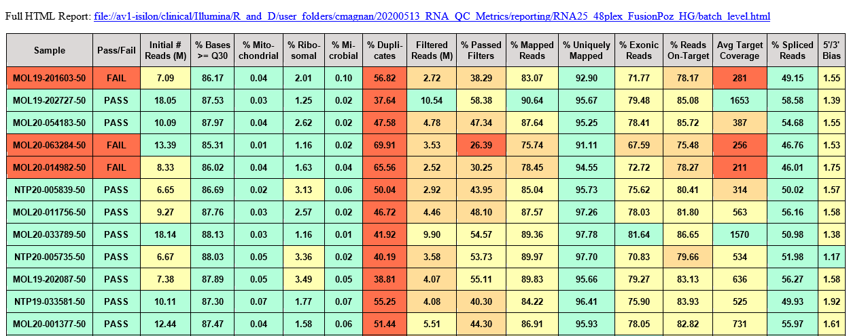
RNA QC Pipeline - Emails

